Slide 2
Topic-1
Earned Value Management (EVM)
Portfolio Management

Slide 3
Earned Value Management
Earned Value Management (EVM) is a systematic approach to the integration and measurement of cost, schedule, and technical (scope) accomplishments on a project or task.
Earned Value (EV) directly links all three primary project success Metrics (cost, schedule, and performance).

Slide 4
Earned Value Management
By using Earned Value and implementing an Earned Value Management System (EVMS), the following questions can be answered objectively:
Where have we been?
Where are we now?
Where are we going?

Slide 5

Traditional management Vs Earned Value Management
Traditional management provides you with…
How much money and time a particular job is likely to require prior to starting and once stated, how much money was spent at any given time.
While Earned Value Management provides you with…
How much money and time a particular job is likely to require prior to starting and once stated, how much money was spent at any given time.

Slide 6
Earned Value Terms
Planned value (PV)
Earned value (EV)
Actual cost of work performed (AC)
Schedule variance (SV) and Schedule performance index (SPI)
Cost variance (CV) and Cost performance index (CPI)
Budgeted cost at completion (BAC)
Estimate at completion (EAC)

Slide 7

Steps in Earned Value Management
Clearly define each activity including its resource needs and budget.
1
Create usage schedules for activities and resources.
2
Develop a time-phased budget (PV).
3
Total the actual costs of doing each task (AC).
4
Calculate both the budget variance (CV) and schedule variance (SV).
5

Slide 8

Earned Value Example
Schedule Variances
Planned Value (PV) = 103
Earned Value (EV) = 44
Schedule Performance Index = .43 = 44/103 = EV/PV
Estimated Time to Completion = (1/.43)x7=16.3 months
Cost Variances
Cumulative Actual Cost of Work Performed (AC) = 78
Cost Performance Index = .56 = 44/78 = EV/AC
Estimated Cost to Completion = $210,714 = (1/.56)x$118,000

Slide 9

An Earned Value Management System (EVMS) framework
The EVMS framework can be divided into three phases:
  1. Inputs - what is needed to implement Earned Value
  2. Earned Value Methods – formulas, metrics and performance measurements used
  3. Outputs – reporting requirements (structure, time-phases, details)

Slide 10
An Earned Value Management System (EVMS) framework
WBS/OBS
Project
Schedule
Resource Planning
Define/Assign
Schedule/Budget
Plan
Establish Baseline
Performance Measurement
Early Warning & Detection
Earned Value
Informed Management Decisions
Corrective Actions
Recovering Planning
Management
System
Actuals
Accounting
System
Funding
$$$
Notes:
A graphic showing the input needed for earned value. These input are showed going into a box called Earned Value Management System. Then there is an arrow showing the outputs from the EVMS box. The graphic is emphasizing the inputs with shading.

Slide 11
What is Portfolio Management?
Gathering
Gathering candidate ideas for investment from various sources (internal and external)
Considering
Considering candidate and approved projects based upon an analytic decision-making framework
Choosing
Choosing highly ranked projects that together meet constraints for budget and resources.
Reporting
Reporting on changes, progress, and results in the portfolio
Reconsidering
Reconsidering the portfolio on an ongoing basis
Practicing
Practicing continuous improvement of Portfolio Management processes.

Slide 12
Eight key processes are involved in choosing the right Portfolio
Identification
Categorization
Elaboration
Evaluation
Prioritization
Selection
Reporting
Improvement

Slide 13
Topic-2
Quality Planning, Quality Assurance and Quality Control
Quality Control Tools

Slide 14
Definitions of Quality
Quality is meeting or exceeding customer’s expectations
Quality is the totality of features and characteristics of a product or service that bears on its ability to satisfy stated or implied needs.
Quality is sum of the attributes that can describe a project or product.
Quality refers to meeting specifications and performance standards.
Managing the quality of the software process and products is important.

Slide 15
How Do We Manage Quality?
Three processes
  Plan Quality
  Perform Quality Assurance
  Perform Quality Control
Plan
Quality
Perform Quality Assurance
Perform Quality Control

Slide 16
Quality management activities
Quality assurance
  Establish organisational procedures and standards for quality
Quality planning
  Select applicable procedures and standards for a particular project and modify these as required
Quality control
  Ensure that procedures and standards are followed by the software development team
Quality management should be separate from project management to ensure independence

Slide 17
Quality Assurance & Quality Control
Quality assurance aims to assure that quality work and quality deliverables will be built in before work is done
Quality control aims to determine that quality work and quality deliverables did occur after work was done
Quality control is conducted by inspection and testing Of materials, workmanship and product

Slide 18
Quality Assurance Vs Control
Quality Assurance is process oriented and focuses on defect prevention.
QA is a set of activities for ensuring quality in the processes by which products are developed.
Whereas
Quality Control is product oriented and focuses on defect identification.
QC is a set of activities for ensuring quality in products. The activities focus on identifying defects in the actual products produced.

Slide 19
Focus- Assurance Vs Control
QA aims to prevent defects with a focus on the process used to make the product. It is a proactive quality process.
QC aims to identify (and correct) defects in the finished product. Quality control, therefore, is a reactive process.

Slide 20
Software Quality Assurance
Software quality assurance (SQA) consists of a means of monitoring the software engineering processes and methods used to ensure quality.
The methods by which this is accomplished are many and varied, and may include ensuring conformance to one or more standards, such as ISO 9000 or a model such as CMMI.

Slide 21
SQA
SQA encompasses the entire software development process, which includes processes.
  Requirements definition,
  Software design,
  Coding,
  Source code control,
  Code reviews,
  Change management,
  Configuration management,
  Testing,
  Release management, and
  Product integration.

Slide 22
Quality planning
A quality plan sets out the desired product qualities and how these are assessed and define the most significant quality attributes.
It should define the quality assessment process.
It should set out which organisational standards should be applied and, if necessary, define new standards.

Slide 23
Quality plan structure
Product introduction
Product plans
Process descriptions
Quality goals
Risks and risk management
Quality plans should be short, succinct documents
– If they are too long, no-one will read them

Slide 24
Quality plans
quality standards and procedures should be documented in an organization’s quality manual
for each separate project, the quality needs should be assessed
select the level of quality assurance needed for the project and document in a quality plan

Slide 25
Typical contents of a quality plan
scope of plan
references to other documents
quality management, including organization, tasks, and responsibilities
documentation to be produced
standards, practices and conventions
reviews and audits
scope of plan
references to other documents
quality management, including organization, tasks, and responsibilities
documentation to be produced
standards, practices and conventions
reviews and audits

Slide 26
0. Select project
1. Identify project scope and objectives
2. Identify project
infrastructure
3. Analyse
project characteristics
4. Identify the products and
activities
Review
5. Estimate
effort for each
activity
Lower level detail
For each activity
6. Identify activity risks
10. Lower level planning
7. Allocate resources
9. Execute plan
8. Review/ publicize plan

Slide 27
7 Basic Quality Control Tools (7QC)
Cause & Effect Diagram
Flowchart
Histogram
Pareto Chart
Check Sheet
Scatter Diagram
Control Chart

Slide 28
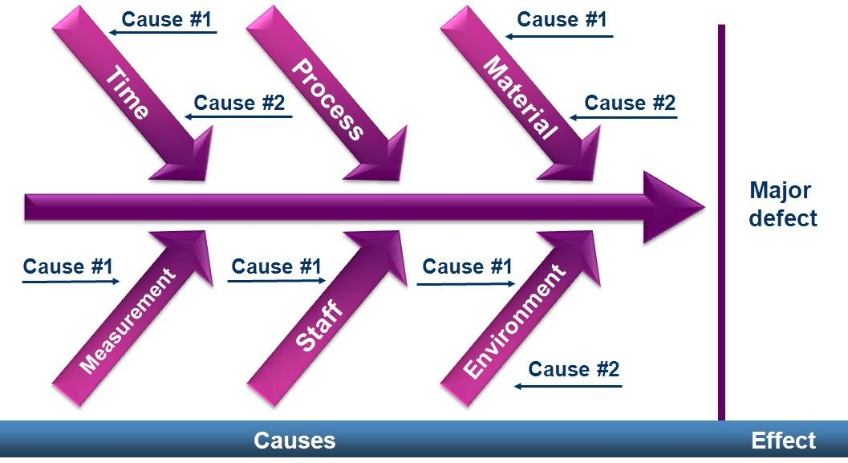
Cause & Effect Diagram
To identify cause and effect relationship

Slide 29
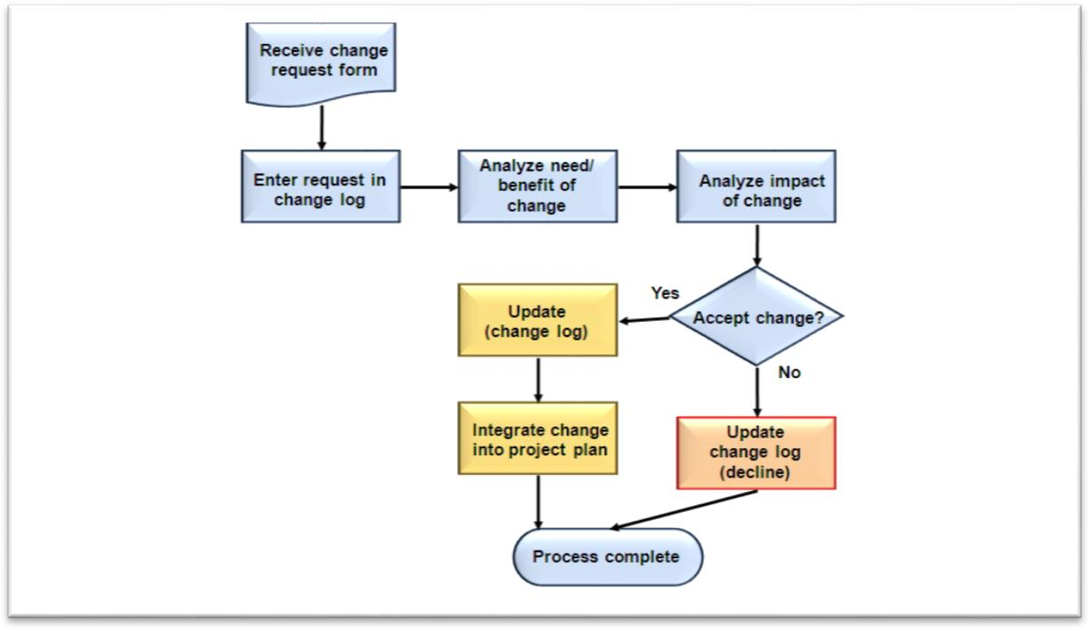
Flow Charts
Basic processing performed when collecting data.
Flowcharts show the logical steps in a process and how various elements within a system are related.
They can be used to determine and analyse potential problems in quality planning and quality control.

Slide 30
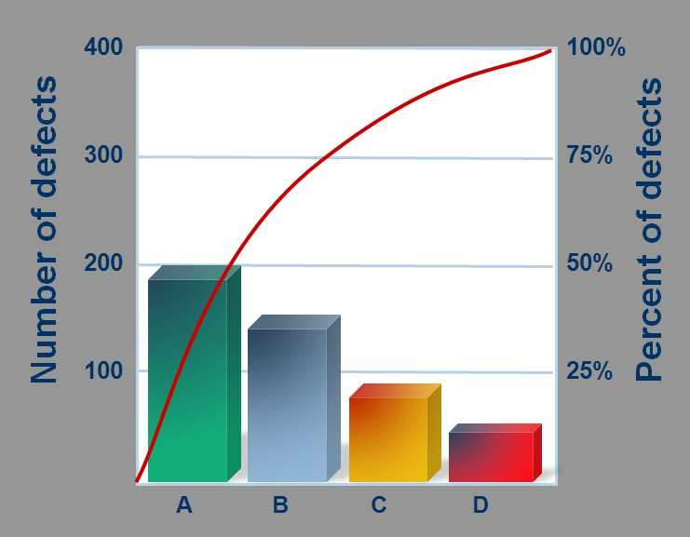
Pareto diagram
To identify current status and issues.
Based on Pareto’s principle, frequently referred to as the 80/20 rule or 80/20 principle. Which means that eighty percent of the cost of defects are caused by twenty percent of the problems.

Slide 31
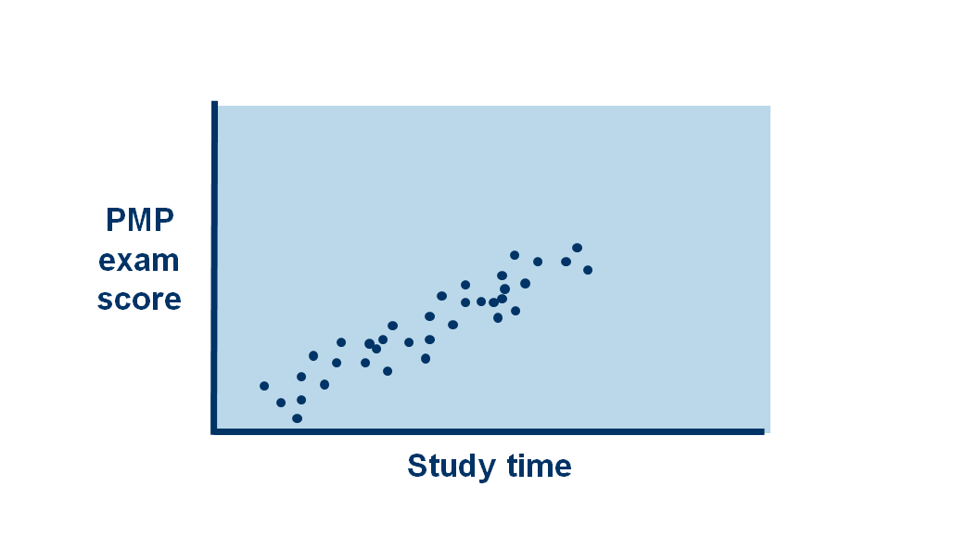
Scatter Diagram
To identify relationship between two things.

Slide 32
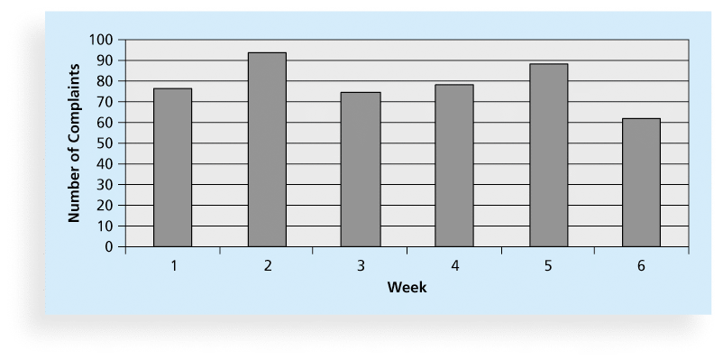
Histogram
To see the distribution of data.
A histogram is a bar graph of a distribution of variables.

Slide 33
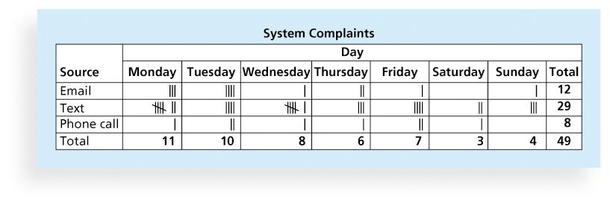
Check Sheets
To record data collections

Slide 34
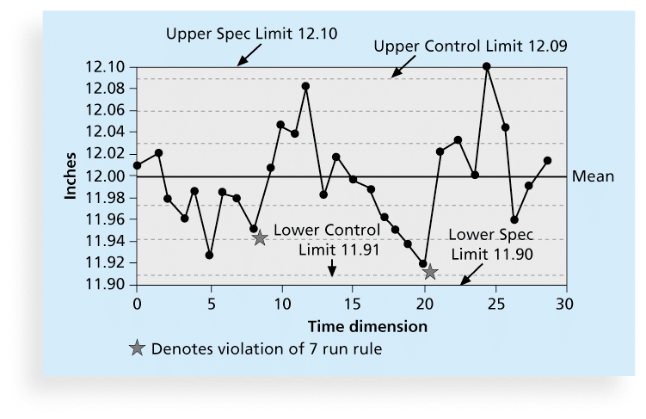
Control Chart Graph
To find out abnormalities and finding the current status.

